Slide 1
AML TRAINING
(Updated Sep 2021)
INTER CITY MONEY LIMITED
1A PARSON STREET, KEIGHLY, BD21 3EY
TEL: 01535 685754
COMPANY NO: 04279071
MSB REGISTRATION NO: 12112657
FCA FRN: 514406

Slide 2
TRAINING INTRODUCTION

Slide 3

TRAINING INTRODUCTION
As an employee of an agent working under Inter City Money Ltd you required to complete AML training before conducting any form of money transfer. As you have direct contact with the customer, you are in the best position to make an informed decision to Know Your Customer (KYC), recognize suspicious activity and report to the Nominated Officer also known as Money Laundering Officer (MLRO).
Failure to comply with these basic principles you could be breaking the law and could be subject to civil and/or criminal penalties.

Slide 4
MONEY LAUNDERING

Slide 5
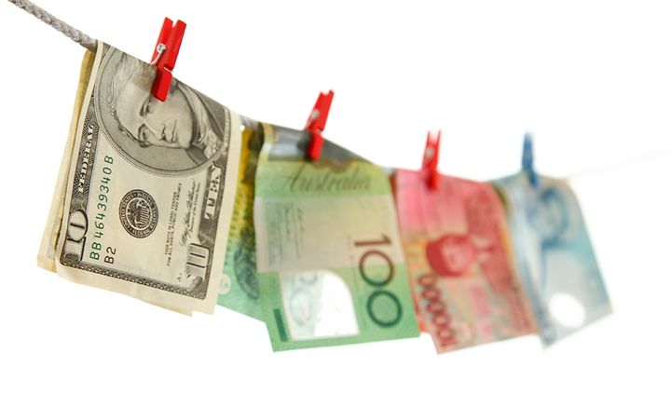
WHAT IS MONEY LAUNDERING?
Money laundering is the generic term used to describe the process by which criminals disguise the source of money that was obtained illegally by re-circulating through the financial system and making such proceeds appear to have come from a legitimate source.

Slide 6
Causes of Monday laundering
Absence of Legislation
Evasion of Tax
Increase in Profits
To make black Money appear white Money
Limited risk of Exposure

Slide 7
EXAMPLES OF MONEY OBTAINED FROM CRIMINAL ACTIVITIES
White Collar Crimes
Counterfeiting and Forgery
Kidnapping
Tax Evasion
Drug Trafficking
Criminal Activity
Bribery / Corruption
Gambling Robbery & Fraud
Extortion
Smuggling (arms, people, goods)
Prostitution

Slide 8
STAGES OF MONEY LAUNDERING
Three basic stages of Money Laundering involve Placement, Layering and Integration. Money laundering schemes can be very simple or highly sophisticated.
PLACEMENT
LAYERING
INTEGRATION
The process of getting criminal money into the financial system;
The process of moving money in the financial system through complex transactions, often via companies and trusts;
The process by which criminal money ultimately becomes absorbed into the economy as legitimate funds or assets, such as through investment in real estate.

Slide 9
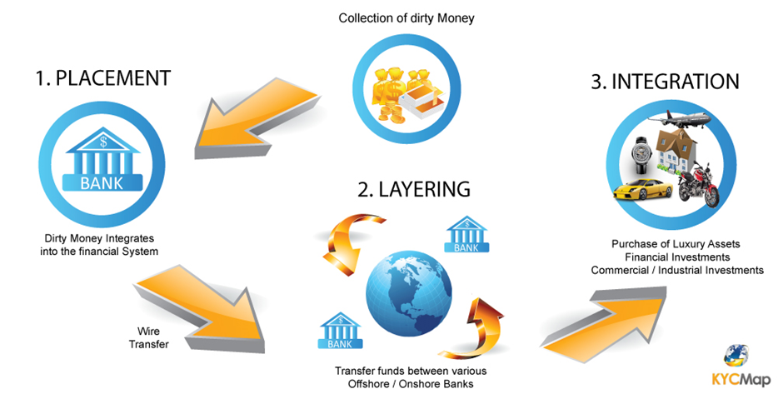
A TYPICAL MONEY LAUNDERING SCHEME

Slide 10
MONEY LAUNDERING ACTIVITIES
These activities includes, but not limited to:
Acquiring, using or possessing criminal property
Handling the proceeds of crimes such as theft, fraud and tax evasion
Being knowingly involved in any way with criminal or terrorist property
Entering into arrangements to facilitate laundering criminal or terrorist property
Investing the proceeds of crimes in other financial products
Investing the proceeds of crimes through the acquisition of property/assets

Slide 11
Methods of Money Laundering
There are variety of methods that can be used to launder money, smuggling money across borders, creating false invoices so that dirty money can be included in the payment process and foreign currency exchange, are just a few examples.
Given the nature of our business, you should be aware of the following methods of laundering that are more likely to occur at one of our Agent locations:
Use of Nominees
Structuring
Smurfing

Slide 12
Methods of Money Laundering
Nominees:
This is one of the most common methods of laundering and hiding assets. Nominees are used to conduct transactions on the criminal’s behalf. The use of nominees helps to conceal the source and ownership of the illegally obtained funds. A launderer uses family members, friends or associates who are trusted within the community and who will not attract attention when placing funds on behalf of the launderer.
Structuring:
One or more individuals conduct multiple transactions on one or more days in amounts less than the legally required record‐keeping and/or reporting thresholds. Structuring is an illegal activity. Helping a customer avoid record‐keeping requirements by splitting one or more transactions at their request is also illegal. Information about the law is easily obtained, so money launderers will try to split transactions into smaller amounts to remain anonymous. If they don’t have to give ID, they can conceal their identity and there will be no paper trail linking them to the money laundered or criminal activity.
Smurfing:
Many individuals who structure transactions by placing the funds at various institution. The funds subsequently transferred to one common receiver, a central bank account or another financial product.

Slide 13
MONEY LAUNDERING EXAMPLES
These activities includes, but not limited to:
Mustafa generates large sums of money by selling illegal drugs. Now he must find a way to use the funds without attracting attention to his criminal activity.
He uses the services of a Money Service Business (MSB) by splitting the transactions below the ID threshold to various individuals who deposit it in bank account that Mustafa controls.

Slide 14
Example
If a customer try to send money in the behalf of group of friend you can directly Refused the transaction
If customer send money on the behalf of family, than customer should provide authority letter from sender

Slide 15
WHAT IS TERRORIST FINANCING?
Terrorist financing provides funds for terrorist activity. It may involve funds raised from legitimate sources, such as personal donations and profits from businesses and charitable organizations, as well as from criminal sources, such as the drug trade, the smuggling of weapons and other goods, fraud, kidnapping and extortion.
Terrorists use techniques like those of money launderers to evade authorities' attention and to protect the identity of their sponsors and of the ultimate beneficiaries of the funds. However, financial transactions associated with terrorist financing tend to be in smaller amounts than is the case with money laundering, and when terrorists raise funds from legitimate sources, the detection and tracking of these funds becomes more difficult.

Slide 16
EXAMPLES OF TERRORIST FINANCING
A foreign organization on a government watch list needs to provide funds to its operatives for a terrorist act. The funders understand that sending large amounts of money, even legal money, will arouse suspicion.
Therefore, they divide a large sum into smaller amounts, which they transfer to associates claiming to be foreign students living abroad. These individuals posing as students then pass the money to the operatives.

Slide 17
PENALTIES
If a person fails to comply with the Money Laundering Regulations, they may face a civil financial penalty or criminal prosecution that could result in an unlimited fine and/or a prison term of up to 2 years.
For example, ignoring “red flags” that indicate that funds could involve illegal activities can potentially expose a person or business to criminal penalties under the legal doctrine known as “willful blindness.” You may be subject to a penalty if:
You agree to, or are involved in committing a crime
A crime is committed because of your neglect

Slide 18
5th AMLD Summary Points
Extends the scope to virtual currency platforms and wallet providers, tax related services and traders of art
Grants access to the general public to beneficial ownership information of EU based companies
Makes it an obligation to consult the beneficial ownership register when performing AML due diligence
Obliges member states to create a list of national public offices and functions that qualify as politically exposed (PEP)
Introduces strict enhanced due diligence measures for financial flows from high-risk third countries
Ends the anonymity of bank and savings accounts, as well as safe deposit boxes and creates central access mechanisms to bank account and safe deposit boxes holder information throughout the EU
Makes information on real estate holders centrally available to public authorities
Lowers thresholds for identifying purchasers of prepaid cards and for the use of e-money
Further enhances the powers of the FIUs and facilitates cooperation and information exchange among authorities

Slide 19
CUSTOMER DUE DILIGENCE (CDD)

Slide 20
WHAT IS CUSTOMER DUE DILIGENCE ?
Customer due diligence means taking steps to identify your customers and checking they are who they say they are. In practice this means obtaining a customer’s:
Name
Photograph on an official document which confirms their identity
Residential address or date of birth
The best way to do this is to ask for a government issued document like a passport, along with utility bills, bank statements and other official documents. Other sources of customer information include the electoral register and information held by credit reference agencies such as Experian and Equifax.
You also need to identify the ‘beneficial owner’ in certain situations. This may be because someone else is acting on behalf of another person in a particular transaction, or it may be because you need to establish the ownership structure of a company, partnership or trust.
As a general rule, the beneficial owner is the person who’s behind the customer and who owns or controls the customer. Or it’s the person on whose behalf a transaction or activity is carried out.

Slide 21

IMPORTANCE OF CUSTOMER’S INFORMATION
Customer Due Diligence (CDD) and Know Your Customer (KYC) checks are the best way to prevent money laundering.
These information and supporting documents to allow us to better understand new customers and why they want to use our services.
By knowing the customer, you can assist in identifying potential money laundering patterns.
From this information, a customer’s pattern can be monitored for any discrepancies or unusual transactions.

Slide 22
WHEN YOU NEED TO APPLY CUSTOMER DUE DILIGENCE MEASURES?
You must apply customer due diligence measures:
When you establish a business relationship
When you carry out an ‘occasional transaction’
When you suspect money laundering or terrorist financing
When you have doubts about a customer’s identification information that you obtained previously
When it’s necessary for existing customers - for example if their circumstances change

Slide 23
CUSTOMER DUE DILIGENCE WHEN YOU ARE ESTABLISHING A BUSINESS RELATIONSHIP
A business relationship is one that you enter into with a customer where both of you expect that the relationship will be ongoing. It can be a formal or an informal arrangement.
When you establish a new business relationship you need to obtain information on:
The purpose of the relationship
The intended nature of the relationship - for example where funds will come from, the purpose of transactions, and so on
The type of information that you need to obtain may include:
Details of your customer’s business or employment
The source and origin of funds that your customer will be using in the relationship
Copies of recent and current financial statements
Details of the relationships between signatories and any underlying beneficial owners
The expected level and type of activity that will take place in your relationship

Slide 24
THE CHANGING CIRCUMSTANCES OF YOUR
CUSTOMERS
You need to keep up-to-date information on your customers so that you can:
Amend your risk assessment of a particular customer if their circumstances change
Carry out further due diligence measures if necessary
Changes of circumstance may include:
A big change in the level or type of business activity
A change in the ownership structure of a business

Slide 25
CUSTOMER DUE DILIGENCE FOR NEW CUSTOMERS
These are some of the questions to consider when you take on new customers to help inform your risk profile:
Checking the customer’s identity is difficult
The customer is reluctant to provide details of their identity or provides fake documents
The customer is trying to use intermediaries to protect their identity or hide their involvement
No apparent reason for using your business's services - for example, another business is better placed to handle the transaction
Part or full settlement in cash or foreign currency, with weak reasons

Slide 26
CUSTOMER DUE DILIGENCE FOR REGULAR AND EXISTING CUSTOMERS
These are some of the questions to consider to help inform your risk profile in relation to your regular and existing customers:
The transaction is different from the normal business of the customer
The size and frequency of the transaction is different from the customer’s normal pattern
The pattern has changed since the business relationship was established
There has been a significant or unexpected improvement in the customer’s financial position
The customer can't give a proper explanation of where money came from

Slide 27
CUSTOMER DUE DILIGENCE FOR TRANSACTIONS
These are some of the questions to consider to help inform your risk profile in relation to the transactions you carry out:
A third party, apparently unconnected with the customer, bears the costs, or otherwise pays the transaction costs
An unusually big cash or foreign currency transaction
The customer won’t disclose the source of the funds
Unusual involvement of third parties, or large payments from private funds, particularly where the customer appears to have a low income
Unusual source of funds

Slide 28
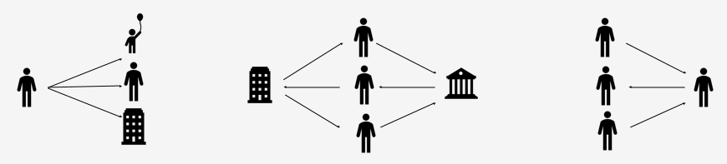
CUSTOMER DUE DILIGENCE IN CASE OF POTENTIALLY LINKED TRANSACTIONS
Once a potentially linked transaction has been identified, you need to decide if it has been deliberately split. Some issues to consider are when:
A number of transactions have been made by the same customer in a short period of time
It’s possible that a number of customers have carried out transactions on behalf of the same person
A number of customers have sent money transfers to the same person
You also have to carry out customer due diligence measures for occasional transactions that are worth less than €15,000 in certain circumstances. For example, you must do this when the nature of a transaction means that there’s a higher risk of money laundering.

Slide 29
WHEN TO CARRY OUT ENHANCE DUE DILIGENCE (EDD)
‘Enhanced due diligence’ means in situations that are high risk, taking additional measures to identify and verify the customer’s identity and source of funds and doing additional ongoing monitoring. In some situations you must carry out ‘enhanced due diligence’. These situations are:
When the customer isn’t physically present when you carry out identification checks
When you enter into a business relationship with a ‘politically exposed person’ - typically, a politically exposed person is an overseas member of parliament, a head of state or government or a government minister (note that a UK politician isn’t a politically exposed person)
Any other situation where there’s a higher risk of money laundering

Slide 30
EDD IN CASE OF CUSTOMERS WHO ARE NOT PHYSICALLY PRESENT
The enhanced due diligence measures for customers who aren’t physically present or non face-to-face, then you must do more due diligence to check their identity, for example:
obtaining further information to establish the customer’s identity
applying extra measures to check documents supplied by a credit or financial institution
making sure that the first payment is made from an account that was opened with a credit institution in the customer’s name
finding out where funds have come from and what the purpose of the transaction is (higher risk situations only)
We don’t advice to take non face-to-face transactions as they are deemed very high risk.

Slide 31
POLITICALLY EXPOSED PERSON (PEP)
Politically Exposed Person is someone who, through their prominent position or influence, is more susceptible to being involved in bribery or corruption. Typically one who has been entrusted with one of the following functions:
Heads of state, heads of government, ministers and deputy or assistant ministers
Members of parliaments
Members of supreme courts, of constitutional courts or of other high level judicial bodies
Members of courts of auditors or of the boards of central banks
Ambassadors, chargés d'affaires and high ranking officers in the armed forces
Members of the administrative, management or supervisory bodies of state-owned enterprises
Or an immediate family member or business associate of any of the above.

Slide 32
EDD WHEN DEALING WITH A POLITICALLY EXPOSED PERSON (PEP)
The enhanced due diligence measures when you deal with a politically exposed person (PEPs) are:
Making sure that only senior management gives approval for a new business relationship
Taking adequate measures to establish where the person’s wealth and the funds involved in the business relationship come from
Carrying out stricter ongoing monitoring of the business relationship

Slide 33
EDD Measures for High-Risk Countries
Additional Measures to Take if Country is identified as High-Risk Country by EU, FATF or HM Treasury.
Rest of Risk Factors have been explained in our Risk Assessment Document.
According to Financial Action Task Force, Due to strategic deficiencies in their regimes to counter money laundering, terrorist financing, and proliferation financing, FATF places PAKISTAN under increased monitoring, it means the Pakistan has committed to resolve swiftly the identified strategic deficiencies within agreed timeframes and is subject to increased monitoring. This list is often externally referred to as the ‘grey list’. http://www.fatf-gafi.org/publications/high-risk-and-other monitored-jurisdictions/documents/increased-monitoring-june-2020.html

Slide 34
Additional Measures to Take:
In case of HIGH RISK EDD is mandatory and Agents/ICM Staff must do more to verify identity and scrutinise the background and nature of the transactions than for standard customer due diligence.
How this goes beyond standard due diligence must be made clear in your risk assessment and procedures. For example:
1. Obtain additional information or evidence to establish the identity from independent sources, such as more documentation on identity or address or electronic verification alongside manual checks.
2. Take additional measures to verify the documents supplied such as by checking them against additional independent sources, or require that copies of the customer’s documentation are certified by a bank, financial institution, lawyer or notary who are competent at document inspection and impostor detection, or a person from a regulated industry or in a position of trust
3. if receiving payment ensure it is made through a bank account in the name of the person you are dealing with.
4. take more steps to understand the history, ownership, and financial situation of the parties to the transaction

Slide 35
5. In the case of a politically exposed person establish the source of wealth and source of funds
6. Carry out more scrutiny of the business relationship and satisfy yourself that it is consistent with the stated purpose.
7. Measures which must be taken when either party to a business relationship, or relevant transaction is established in a high-risk third country (a business is established in a country if they are incorporated there, is their principal place of business, or they are regulated there as a financial or credit institution; an individual is established in a country if they are resident there)
8. Obtain additional information on the customer and the customer’s beneficial owner
9. Obtain additional information on the intended nature of the business relationship
10.Obtain information on the source of funds of the customer and of the customer’s beneficial owner
11. Obtain information on the reasons for the transaction
12. Obtain the approval of senior management for establishing or continuing the business relationship
13. Enhance monitoring of the business relationship by increasing the number and timing of controls applied, and select patterns of transactions which require further examination

Slide 36
As of 2019, FATF has blacklisted North Korea and Iran over terror financing.
Jurisdictions under Increased Monitoring - June 2021
Jurisdictions with strategic deficiencies
Albania, Barbados, Botswana, Burkina Faso, Cambodia, Cayman Islands, Haiti, Jamaica, Malta, Mauritius, Morocco, Myanmar, Nicaragua, Pakistan, Panama, Philippines, Senegal, South Sudan, Syria, Uganda, Yemen, Zimbabwe
Jurisdiction no longer subject to increased monitoring
Ghana

Slide 37
IDENTIFICATION TRAINING

Slide 38
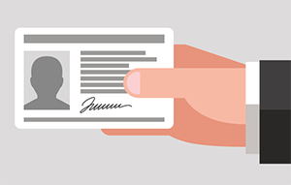
IDENTIFICATION
There are specific requirements on what types of identification are acceptable for financial transactions. Management and staff is responsible for knowing and complying with the rules specific to their location.
Sender has to be identified through an acceptable ID document to send transactions regardless of transaction size.

Slide 39
DOCUMENTS FOR ACCEPTABLE IDENTIFICATION
Acceptable IDs must be original, currently valid government-issued identification documents with a photograph; for example,
Proof of full name, place and date of birth:-
Current signed passport
Current full photo card driving license (UK only)
National Identity Card (EU only with the exception of UK)
Inland Revenue Card
ID Card by the electoral office of Northern Ireland

Slide 40
DOCUMENTS FOR ACCEPTABLE IDENTIFICATION
Proof of Current/permanent Residential Address:-
Utilities bill dated within the last three months
Current UK full or provisional photo card drivers license (If not used as proof for identification purpose)
Bank, building society, or credit union statement dated within the last three months

Slide 41

AGE FOR CONDUCTING TRANSACTION
Consumers conducting transactions must be at the age of majority, which is 18 or older in UK.

Slide 42
TRANSACTION GET REFUSED BECAUSE OF THE FOLLOWING REASONS
Consumer is not the age of majority (18 years of age or older).
Consumer does not have identification.
Identification provided is not on the list of acceptable forms of identification.
Identification is not the original document-photocopies of identification are not acceptable.
Identification document does not match the consumer.
Identification appears to be a forgery or appears to have been altered.

Slide 43
IMPORTANCE OF ACCEPTABLE ID
Consumers have to be identified through an acceptable ID document for send transactions regardless of transaction size.
Additionally, consumers have to be identified through an acceptable ID document on all receive transactions regardless of the amount.

Slide 44
INFORMATION REQUIRED TO COMPLETE THE TRANSACTION
You must gather and enter the required information before the transaction can be completed. Customer information should be verified and recorded exactly as it appears on the ID document i.e. Full name, D.O.B, Place of birth, expiry date, document number, etc.
It is important that you carefully check the spelling of customer information on ID document and provide the correct details in a valid format to avoid delay in processing transaction.

Slide 45
Determine the true identification of each customer (according to the MLR 2017) seeking to conduct a transaction regardless of transaction size & Collect Following Information
Full name
Residential address ( no post box)
Date of birth
Place of birth
Nationality
ID document type
ID number
Expiration Date of the ID
ID Issuing authority

Slide 46
On transactions of 5000 GBP and above the sender must be verified through an acceptable photo ID document and proof of residential address should be taken. The following must be recorded:-
Full name
Residential address ( no post box)
Date of birth
Place of birth
Nationality
ID document type
ID number
Expiration Date of the ID
ID Issuing authority

Slide 47
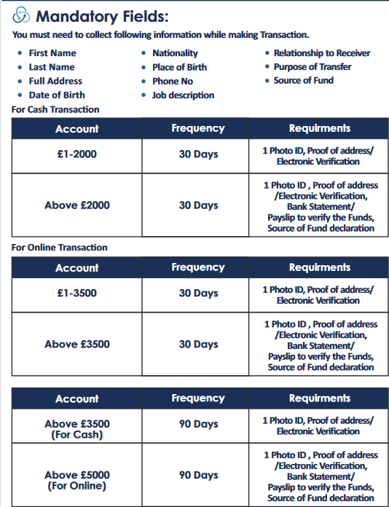
CHECKS WHEN CUSTOMER MAKE ONE-OFF TRANSACTION
£1 to £2,000
£2,500
One-off
£5000 & Above
£8,500 & Above
Basic Information
Full Name
Residential Address
Date of Birth
Nationality
Telephone Number
1 Photo ID
Basic Information
1 Photo ID
1 Proof of Address
Declaration form
Basic Information
1 Photo ID
1 Residential ID
Source of funds
Declaration form
Basic Information
1 Photo ID
1 Residential ID
Source of funds
Large transaction form +EDD

Slide 48
RECORD KEEPING

Slide 49

RECORD TO BE KEPT SAFE
You must retain:
Copies of, or references to, the evidence obtained of a customer’s identity, for 5 years after the end of the business relationship
Details of customer transactions and signed receipts must be kept safe for at least 5 years from the date of transaction.
Details of actions taken in respect of internal and external suspicion reports for at least 5 years.

Slide 50
HOW RECORD SHOULD BE KEPT
You can keep records as
original documents,
photocopies of original documents, in either
computerized or electronic form.
The aim is to ensure that the business meets its obligations and, if requested, can show how it has done so. This evidence may be used in court proceedings against the criminals.

Slide 51
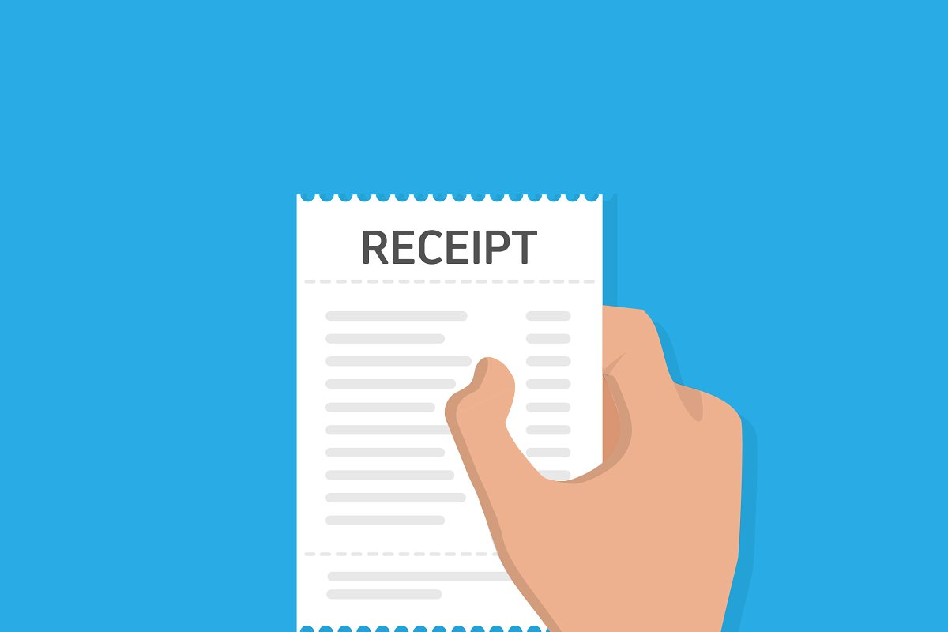
SIGNED RECEIPT OF TRANSACTIONS
It is the staff responsibility to get receipt signed from the customer, every time they make a transaction.

Slide 52
SUSPICIOUS ACTIVITY REPORT (SAR)

Slide 53
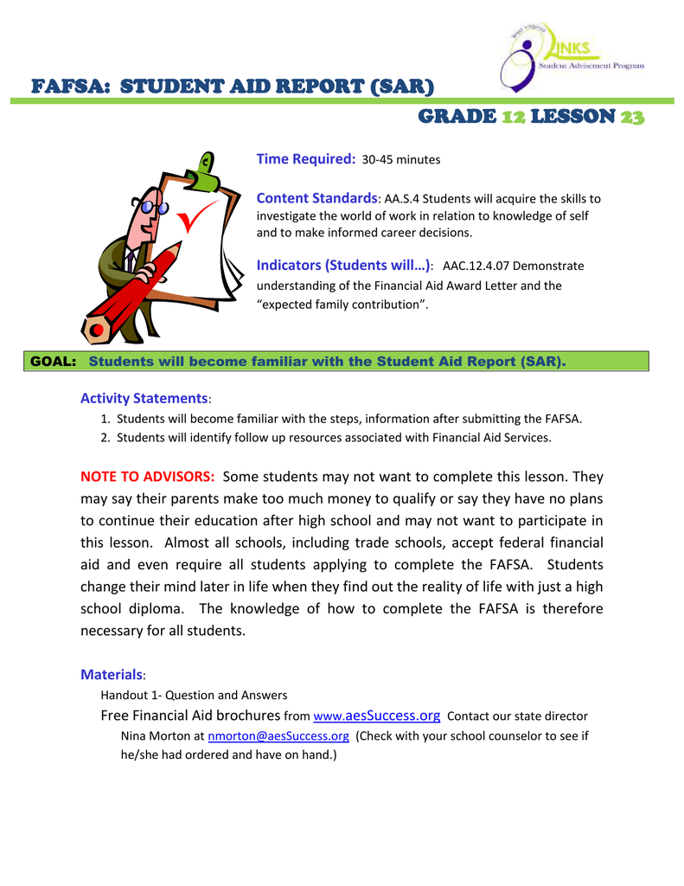
SUSPICIOUS ACTIVITY REPORT (SAR)
WHAT IS SUSPICIOUS ACTIVITY REPORT (SAR)?
A SAR is a Suspicious Activity Report, a piece of information which alerts law enforcement that certain client/customer activity is in some way suspicious and might indicate money laundering, structure transactions to avoid reporting or record keeping requirements and/or terrorist financing.

Slide 54

REASON FOR SUSPICION
There are many reasons why you or one of your employees might become suspicious about a transaction or activity. Often it’s just because it’s something unusual for your business - perhaps a customer has tried to make an exceptionally large cash payment. Maybe the customer behaved strangely, or made unusual requests that didn’t seem to make sense. Perhaps the transaction they wanted to make just didn’t add up commercially.
You must look carefully at all unusual transactions to see if there’s anything suspicious about them.
Some of the most common “red flags” for suspicious activity are:
Structuring
Consumers working together in an unusual manner
Unusual transaction patterns
Flipping
Unusual Behavior

Slide 55
REASON FOR SUSPICION
Structuring
This involves breaking down cash deposits into smaller amounts below the reporting threshold either on the same day or consecutive days.
Customers working together in an unusual manner
Customers that appear as though their transactions are somehow related may indicate the following:
  ID Avoidance
  Recordkeeping avoidance
  Avoiding disclosing the source of funds
  Other organized criminal activity

Slide 56
REASON FOR SUSPICION
Unusual Transaction Patterns
You know the typical nature and reason for transactions at your location. Many customers within a specific location may have similar transaction habits, including sending origination, amount and purpose. If a customer attempts a transaction that seems unusual for normal customer practice at your location, this may indicate suspicious activity.
Example
A customer with no reason for using the firm’s service, e.g. clients with distant addresses who could find the same services nearer their home base; clients whose requirements are not in the normal pattern of the firm’s business which could be more easily serviced elsewhere would indicate suspicious activity.

Slide 57
REASON FOR SUSPICION
Flipping
When a customer receives a payment, potentially keeps a small portion and immediately sends the remaining amount to another person. Transaction flipping is used primarily to break the chain between original sender and receivers to avoid reporting and record keeping requirements.
Unusual Behavior are classified as observable behaviors that seem suspicious, questionable, or concerning.
Example of Unusual Behavior customer may display that may be considered suspicious:
Is nervous, rushed or aggressive
Is reluctant to show identification
Provides identification that seems unusual, false or altered
Presents a different address each time they complete a money transfer
Spells their name differently or uses a different name each time they complete a money transfer

Slide 58

WHEN TO REPORT SUSPICIOUS ACTIVITY
You must report any suspicious transaction or activity as soon as you become aware to the ‘nominated officer’. It’s the nominated officer’s responsibility to decide whether they need to send a report or send a ‘disclosure’ about the incident to the NCA. They do this by making a Suspicious Activity Report.

Slide 59
WHY SUBMIT SAR?
Submitting a SAR provides law enforcement agencies with valuable information on potential criminality. It also protects you, your organisation and UK financial institutions from the risk of laundering the proceeds of crime.
The law enforcement agency in the United Kingdom to tackle serious organized crime including Money Laundering is: National Crime Agency (NCA)
By submitting an internal SAR report to the Nominated Officer also known as the Money Laundering Reporting Officer (MLRO) who will decide to submit the report to the National Crime Agency (NCA), you will be complying with any potential obligations you have under the Proceeds of Crime Act 2002 (POCA).

Slide 60
WHO DO I SEND SAR TO?
All Suspicious Activity (SAR) should be submitted to the ‘nominated officer’ and the appointed nominated officer/MLRO for Inter City Money is:
Mr Taliq Hussain – taliq@intercitymoney.com Tel: 07870679430
You can submit a Suspicious Activity (SAR) by following methods:
By completing online portal via the customer summary page.
By Email send completed SAR to taliq@intercitymoney.com
By Fax: 01535 685 760
By Post

Slide 61
THE INFORMATION IN THE SAR SUBMITTED IS HELD SECURELY
All users of SARs adhere to specific guidelines to protect the confidentiality of SARs. Once a SAR is received by the NCA, it is held on a secure database. This database has strictly limited access to appropriate law enforcement and government agency staff.
THE INFORMATION IS ALWAYS HELD IN THE STRICTEST CONFIDENCE
If, in the unlikely event you are made aware that any confidentiality may have been breached, you should contact the NCA immediately.
This should be done on Free phone 0800 234 6657.

Slide 62
Bribery Prevention Policy and Procedures

Slide 63
Bribery Prevention Policy and Procedures
In general terms, bribery is committed where a person
offers or gives some benefit to another person
as an inducement for that person
or another person to act dishonestly in relation to his principal’s or employer’s business. In such a case, all those persons (A, B and C), as well as other persons who were complicit in the offence, may be guilty of bribery. It is company policy that all members of staff shall actively avoid and prevent incidents of bribery involving the company, its staff, and any persons or organisations associated with it or acting on the company’s behalf. Nature of a bribe. A bribe may be a cash payment, or it may be a non-cash advantage (such as a gift).

Slide 64
Anti-Fraud Guide for Agents and their Operators

Slide 65
No precise legal definition of fraud exists; many of the offences referred to as fraud are covered by the Theft Acts in England and Wales, and under Common Law in Scotland. The term is used to describe such acts as deception, bribery, forgery, extortion, corruption, theft, conspiracy, embezzlement, misappropriation, false representation, concealment of material facts and collusion.

Slide 66
Other offences are created by more sector specific laws such as those that prohibit corruption or create offences related to companies or financial services, for example.
For practical purposes fraud may be defined as the use of deception with the intention of obtaining an advantage, avoiding an obligation, or causing loss to another party.
This most often occurs in the context of a relationship with a customer, client, or colleague on an individual or organizational basis.

Slide 67
There are four basic ingredients which are necessary for a fraud to occur:
Assets to acquire
People to carry out fraud
Intent to commit the fraud
Opportunity
Types of Fraud
Frauds can be categorized by the type of victim involved. The most common groups of victims encountered by investigators include:
Investors
Creditors
Businesses
Banks or other financial institutions
Central or local government
Fraud by manipulating financial markets

Slide 68
Frauds can also be categorized by the technique or activity used by the fraudster. These include:
Advance fee frauds
Bogus invoices
Computer hacking of information or property
Corruption and bribery
Counterfeiting, forgery, or copyright abuse
Credit Card fraud
False Accounting - manipulation of accounts and accounting records
Fraudulent bankruptcy - exploitation of cross-border corporate structures
Insurance fraud
Internet online scams - auctions, credit card purchases, investment scams
Investment fraud
Long Firm fraud
Misappropriation of assets
Money laundering
Mortgage Fraud
Payroll fraud
Principal agents - failure of systems to restrict key individuals
Pyramid schemes
Unsolicited letter frauds

Slide 69
For update information on issues related to fraud, reference should be made to the Fraud Reduction website published by the National Working Group on Fraud on behalf of the UK Association of Chief Police Officers (ACPO). This is available at: www.fraud-stoppers.info. Or at If fraud has been committed, report it to Action Fraud.
Tips for the Customers
In this final section, we provide you with some important tips in order to stop fraudsters. Observing these tips will significantly reduce the risk of becoming a fraud victim.

Slide 70
Tips for customers to stop fraudsters:
  Never send money to someone you do not personally know.
  Never send money first in order to get something in return later on, like for a lottery, a job, or a loan.
  Do not believe an emergency story from someone who says to be a relative without verifying the person really is your relative.
  Do not believe in offers that state a money transfer is the only possible way of payment.
  Think before you act, an offer that sounds too good to be true is usually too good to be true.
  There is no protection against loss due to a fraudulent money transfer as it is similar to sending cash.

Slide 71
Tips to Avoid Phishing And Identity Theft
Inter City Money Ltd always advice customers to keep the cash in bank account safe and reduce the chances of becoming a victim of fraud by following some simple steps.
First of all, make sure your computer or laptop is protected with a good security software program and antivirus software. Keep them all, along with your browser, up to date.
Different banks have different security measures for online banking but if you have to set up a password, make sure it is a mixture of letters and numbers, and is different from an email password.
If you access your email from an insecure computer, scammers could steal your password details and use them to access your account. Also, don't write your passwords down in full or share them with anyone.

Slide 72
Avoiding Scam Calls And Emails
  Never disclose personal details, such as your password, on email or over the phone unless, of course, it is one you have agreed with your bank for telephone banking.
  However, if you received a call or email from your bank that you weren't expecting, treat it with suspicion, regardless of the apparent name of the organization contacting you. Never follow a link
  from an email purporting to be from your bank and never open an email from an unknown source, as it may contain a virus.
  Before entering your account details into a website, make sure there is a padlock symbol in or next to the address bar in your browser and that the web address changes from starting with 'http' to 'https' – this means the connection is secure.
  If you have a wireless network at home, make sure you have activated the security settings on your wireless router to make it secure and prevent others accessing it.

Slide 73
  Avoid accessing your bank account from a public computer or unsecured wireless network. If you do use a public computer, never leave it unattended when logged in and always log out properly when you've finished your banking session.
  If you experience any problems logging in, phone your bank – don't send an email.
  Avoid posting personal information such as your email address, date of birth and phone number on social networking websites such as Facebook and Twitter to reduce the risk of identity theft. Only accept friend requests from people you know. Someone posing as an interesting person asking to become your friend may actually be an ID thief. Check your privacy settings carefully and make sure only people you trust can view your profile.
  Regularly check your bank account and statements for suspicious transactions. If you spot something unfamiliar, report it to your bank or card provider as soon as you can.

